Slide 1

Beers and Breweries Case Study
By Brittany Lewandowski & Chad Kwong
This Photo by Unknown Author is licensed under CC BY-SA

Slide 2
Question 1 Code
The following code uses the count() function to create a data frame of the count of Breweries per state. GGPlot2 is then used to plot the data frame as a bar plot.
Count_Of_Breweries_By_State = count(Breweries, State)
ggplot_Breweries_By_State = ggplot(data=Count_Of_Breweries_By_State, aes(x=State,y=n,fill=State)) + geom_bar(stat="identity") + theme(axis.text.x=element_text(angle = 90,vjust = 0.5, hjust = 1)) + labs(title="Count of Breweries by State",x= "State",y="Count of States") + geom_text(aes(label=n),vjust=1.6,size=3.5)
ggplot_Breweries_By_State

Slide 3
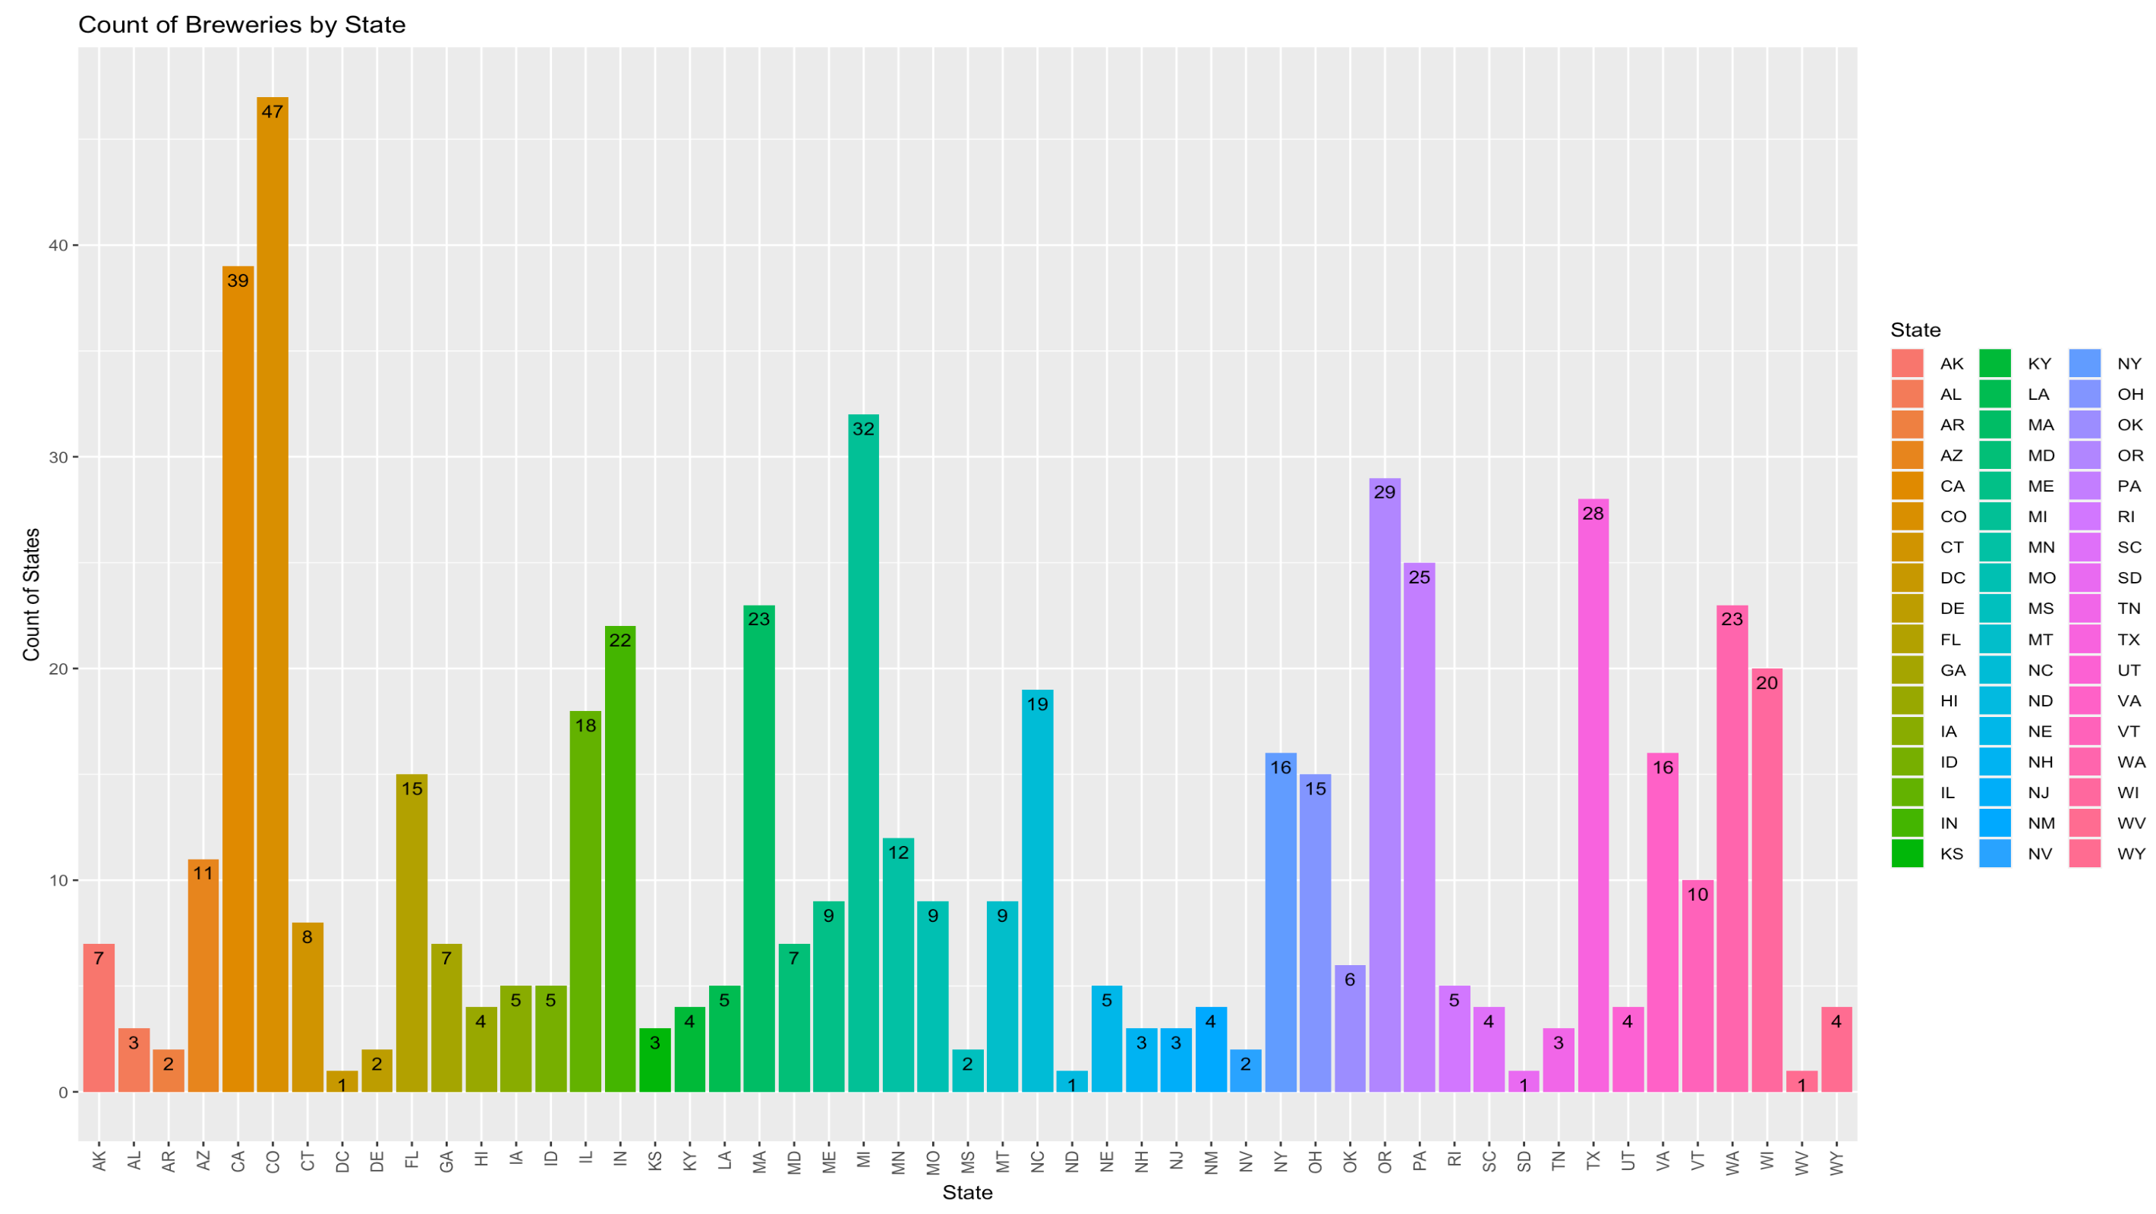
Question 1 Visualization
From the graph on the right, we can see that Colorado has the most breweries at 47 while DC, West Virginia, and South Dakota all have the least amount at 1.

Slide 4
Question 3 Code
The following code uses the na.omit function to remove all NA valued rows from each default dataset
Beers <- na.omit(Beers)
Breweries <- na.omit(Breweries)

Slide 5
Question 4 Code
The code below uses the summaraise function in conjunction with the group_by function to calculate the medians. The medians are then plotted to bar plots using GGPlot2.
StateIBUMedian <- CleanData %>% group_by(State) %>% summarise(Median=median(IBU))
StateABVMedian <- CleanData %>% group_by(State) %>% summarise(Median=median(ABV))
IBUPlot = ggplot(StateIBUMedian, aes(x = State, y = Median, fill = State)) + geom_bar(stat = "identity", width = .9) + ggtitle("Plot of Median IBU per State") + geom_text(aes(label=Median),vjust=0.5, hjust=-.3 ,size=3.5) + coord_flip()
IBUPlot
ABVPlot = ggplot(StateABVMedian, aes(x = State, y = Median, fill = State)) + geom_bar(stat = "identity") + coord_flip() + ggtitle("Plot of Median ABV per State") + geom_text(aes(label=Median),vjust=0.5, hjust=-.2 ,size=3.5)
ABVPlot

Slide 6
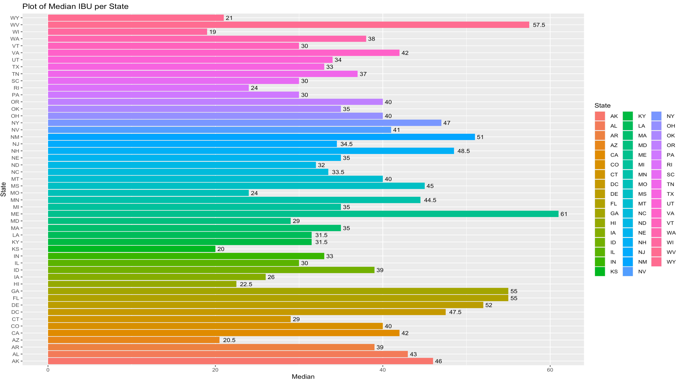
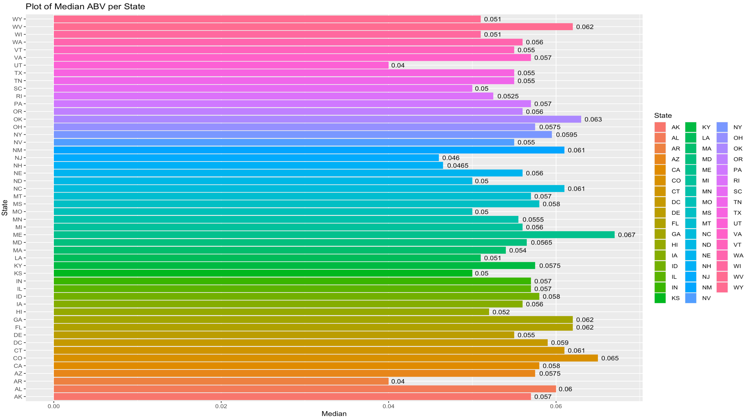
Question 4 Visualization
Using the plots below, we can see that Maine holds the brewery with the highest IBU as well as the highest ABV

Slide 7
Question 5 Code
The code below uses the summarise function combined with the group_by function to create a dataframe of all max values per state. The which.max function is then used as an index to the row with the max value overall. The final result is then displayed for both IBU and ABV
#Max IBU
StateIBU <- CleanData %>% group_by(State) %>% summarise(Max_IBU = max(IBU))
StateIBU[which.max(StateIBU$Max_IBU),]
#Max ABV
StateABV <- CleanData %>% group_by(State) %>% summarise(Max_ABV = max(ABV))
StateABV[which.max(StateABV$Max_ABV),]

Slide 8
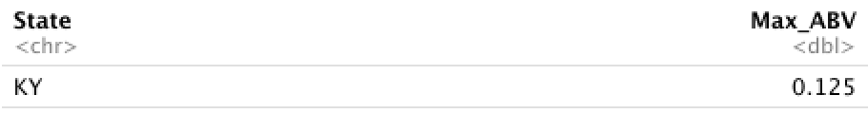
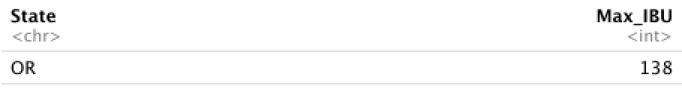
Question 5 Visualization
From the output observed below, we can see that the highest ABV across all states lies in Kentucky at 12.5%, and the highest IBU across all states lies in Oregon at 138 IBU.

Slide 9
Question 6 Code
The code below uses the summary function to list out the statistical values. We then use GGPlot2 to plot a histogram of the ABV as well as a box plot of the ABV
summary(BB_Merged$ABV)
ggplot(data=BB_Merged,aes(x=ABV,fill=State)) + geom_histogram(stat="count") + theme_classic() + labs(title="Distribution of ABV", x="ABV", y="Count of ABV")
boxplot(BB_Merged$ABV,ylab="ABV")

Slide 10

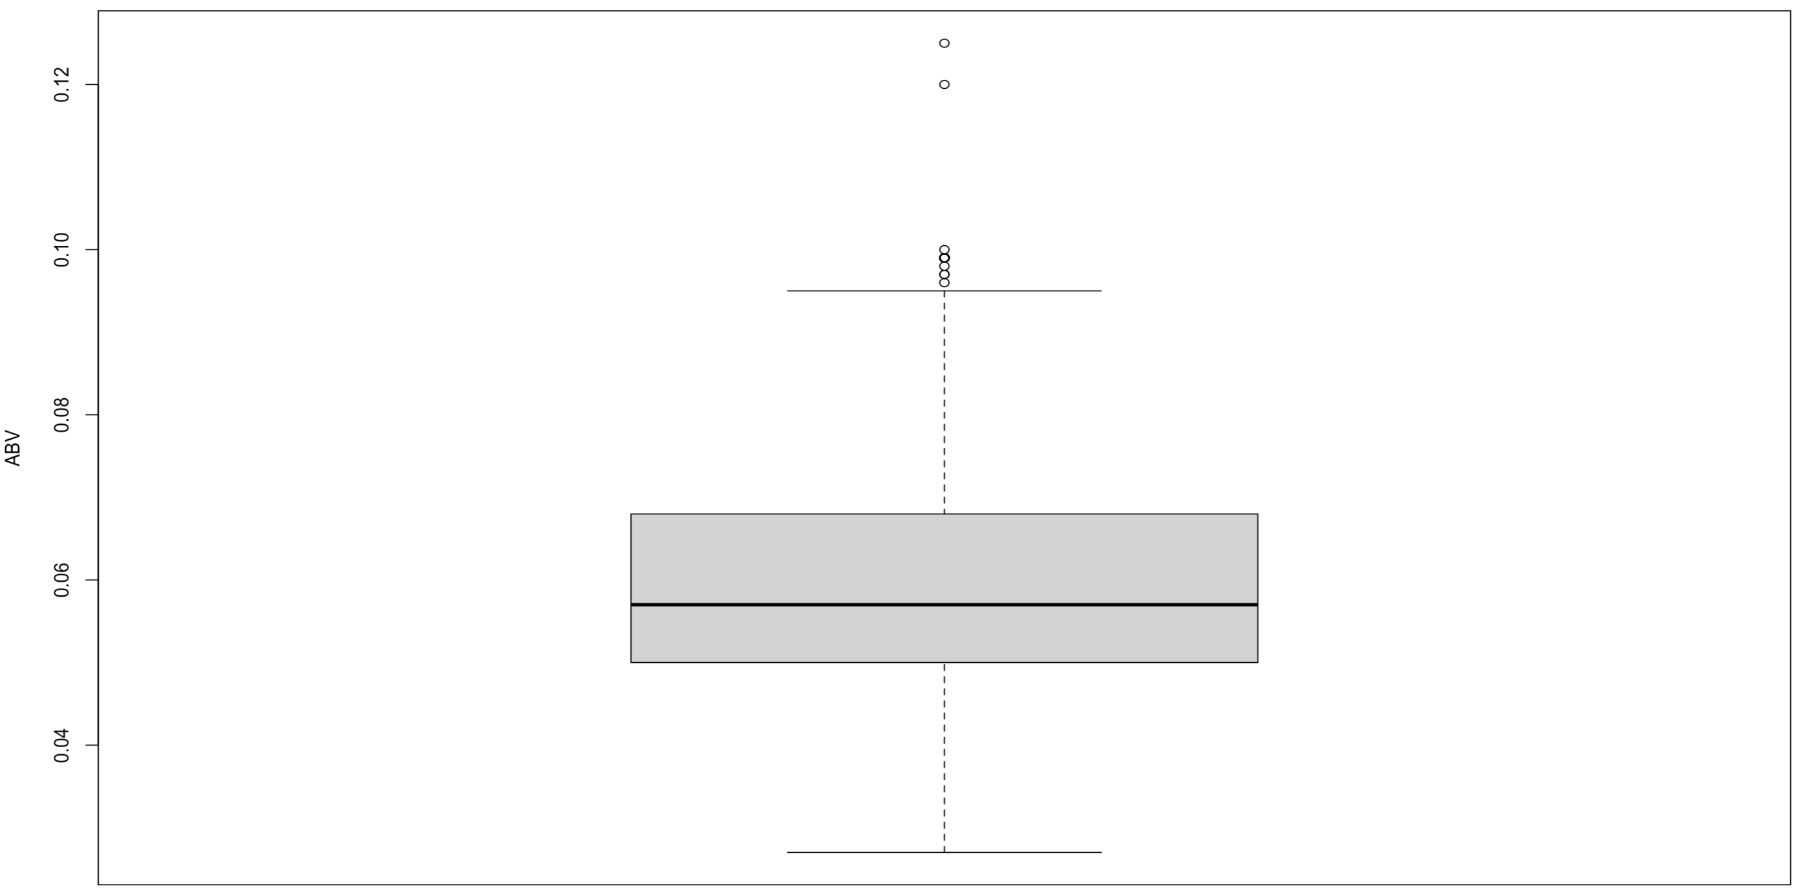
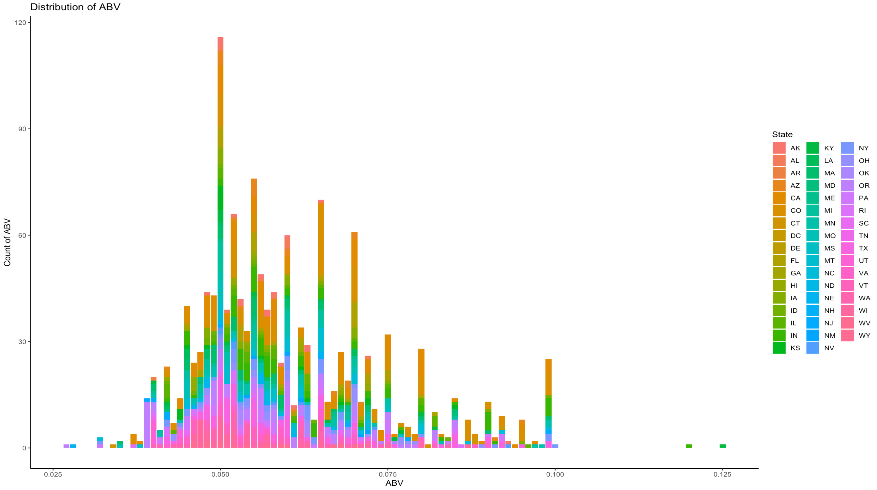
Question 6 Visualization
The plot below shows positive skewness (Skewed Right)
The statistical summary combined with the box plot shows a more heavily weighted 3rd quartile

Slide 11
Question 7 Code
The following code uses GGplot2 to plot the IBU vs ABV as a scatterplot using the geom_point function. A line is then mapped to the scatter plot using the geom_smooth function combined with a linear regression model
ggplot(CleanData, aes(x = ABV, y = IBU, color = -IBU)) + geom_point(position = "jitter") + geom_smooth(method = lm, color = "red") + ggtitle("Scatter Plot of IBU vs ABV")

Slide 12
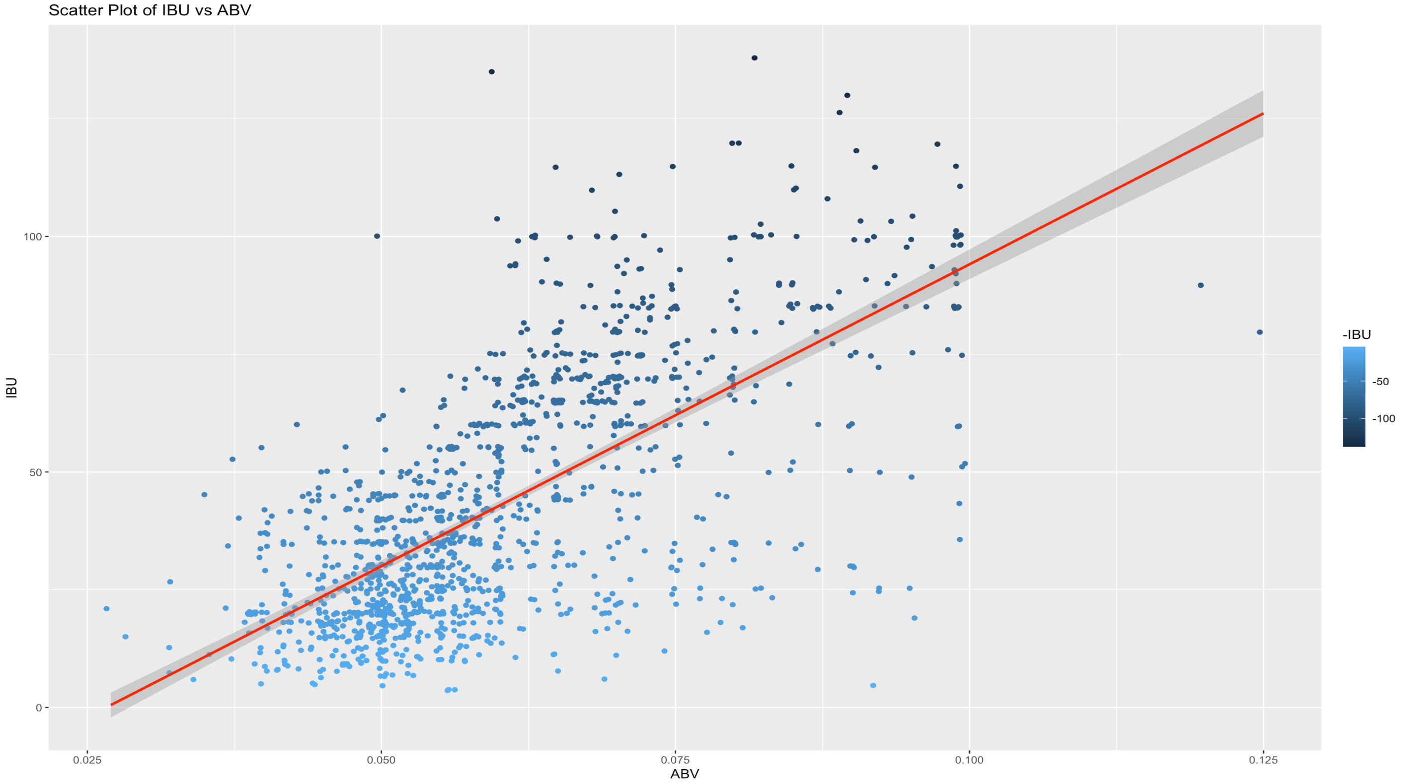
Question 7 Visualization
A positive correlation can be seen from the scatter plot combined with a line using the linear regression model.

